Slide 1
Introduction to Support Vector Machines

Slide 2
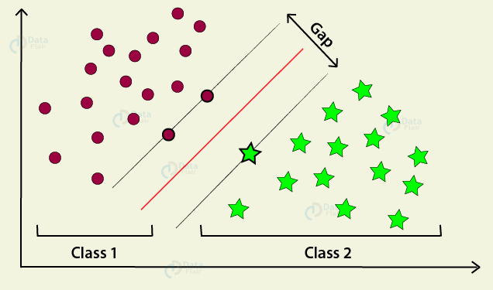
Support Vector Machines
Support Vector Machines or SVMs are supervised learning models with associated learning algorithms that analyze data used for classification and regression analysis.

Slide 3
More about SVMs
SVMs are non-probabilistic, so they assign a data point to a class with 100% certainty.
Two SVMs giving the same class assignment to a set of data points have the same classification accuracy.
If two svms give the same class assignment of data points , the model will choose the data point furthest away from its classification boundary.

Slide 4
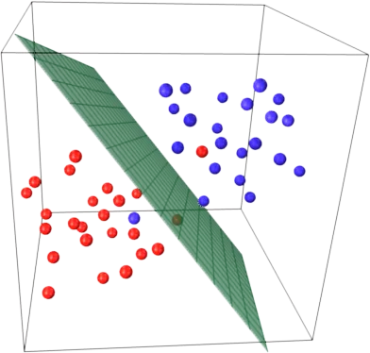
Hyperplanes
Boundary would be a line that passes through the middle of the two closest data points from different classes.
In more than two dimensions, this boundary is known as a hyperplane.

Slide 5
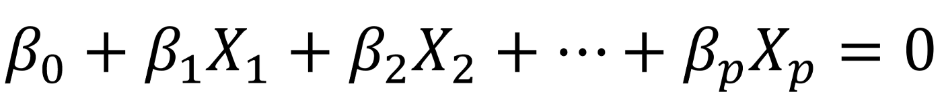
Mathematics behind Hyperplane
If X satisfies the equation above, then the point lies on the plane. Otherwise, it must be on one side of the plane.

Slide 6
What is no Separating Plane Exists?
If there is no maximal margin classifier, We use a support vector classifier that can almost separate the classes using a soft margin called support vector classifier.

